Slide 1
Career Research Project
Nathan Kritikos

Slide 2
Graphic Designer
Graphic designers create concepts by hand or by computer programs, to get the ideas that inspire, inform, or captivate consumers. They develop the overall layout for the final product.

Slide 3
Ten Characteristics
Communication - It’s important for a graphic designer to be in contact with their clients to keep a professional relationship and a
Curiosity - You need to love art and be curious of new types of it so you can be at the top of originality.
Passion - You should love what you’re doing so you can make the best product possible.
Openness - As a graphic designer you must be open minded, and willing to try new things that are out of your comfort zone.
Criticism - You must be able to take criticism well to be able to improve your work and ideas.

Slide 4
Ten Characteristics
Problem Solving - You should be good at problem solving so your bad ideas can evolve into better ones.
Self Doubt - Can be good at sometimes, it keeps you from slacking and taking the easy way out.
Patience - Designing can take a while so you need to be patient with the process.
Reliability - People want to go to someone who's not only talented but always there when they need work done.
Evolution- You should always get better and grow your skill to stay in the business.

Slide 5
Life Style
Salary- 47,000
Work Hours - 40 to 50 hours a week.
I want to drive a nice car and live in a decent house and have money left over to buy needed items, like food , clothes and pay bills.
I wouldn't need to relocate for the job because there is a need for graphic designers everywhere.
The Career cluster is “Arts Audio/Video communication.

Slide 6
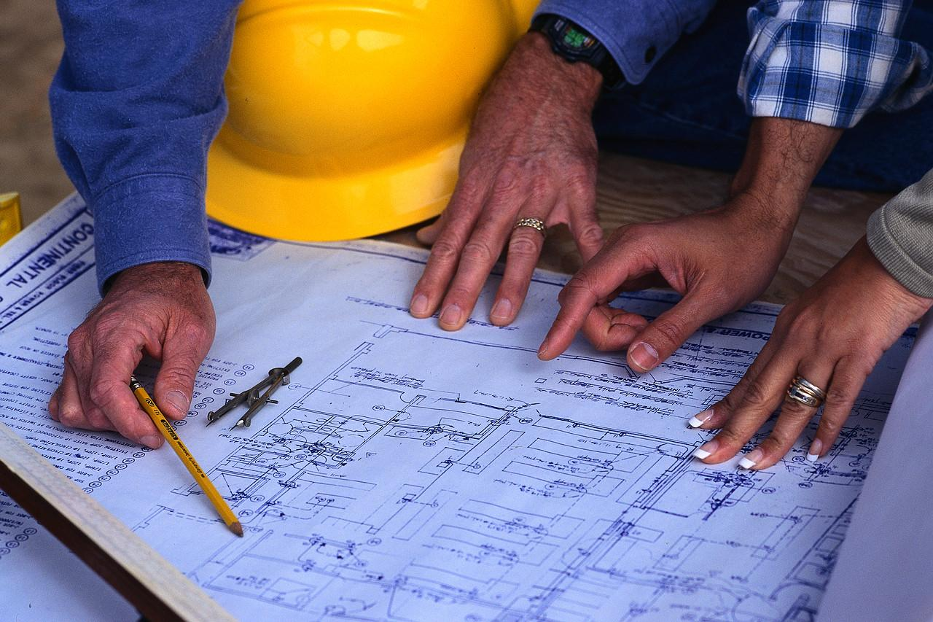
Civil Engineer
Civil engineers create, improve and protect the environment in which we live. They plan, design and oversee construction and maintenance of building structures and infrastructure, such as roads, railways, airports, bridges, harbours, dams, irrigation projects, power plants, and water and sewerage systems.

Slide 7
Ten Characteristics
Strong Analytical Aptitude - excellent analytical skills and continually examining things and thinking of ways to help things work better.
Attention to Detail - Pay meticulous attention to detail. The slightest error can cause an entire structure to fail.
Communication Skills - They can translate complex technical lingo into plain English and also communicate verbally with clients and other engineers working together on a project.
Continuing Education - Changes in technology happen rapidly, and the most successful engineers keep abreast of new research and ideas.

Slide 8
Ten Characteristics
5. Creative - Can think of new and innovative ways to develop new systems and make existing things work more efficiently.
6. Think Logically - able to make sense of complex systems and understand how things work and how problems arise.
7. Mathematically Inclined - Engineering is an intricate science that involves complex calculations of varying difficulty.
8.Problem Solving Skills - An engineer is frequently called upon solely to address problems.

Slide 9
Ten Characteristics
9. Team Player - Working together to make one project come together successfully is important.
10.Technical Knowledge - understand a variety of computer programs and other systems that are commonly used during an engineering project.

Slide 10
Life Style
Salary - 82,000
Work Hours - Depends on the project.
I want to live In a medium size house with a nice car and have money left over to spend on things i want/need.
I wouldn't have to leave michigan because civil engineers are everwhere and always needed.
Career cluster - Science ,Technology , Engineering

Slide 11
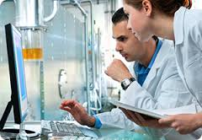
Chemical Engineer
Chemical engineers develop and design chemical manufacturing processes. Chemical engineers apply the principles of chemistry, biology, physics, and mathematics to solve problems that involve the production or use of chemicals, fuel, drugs, food, and many other products.

Slide 12
Ten Characteristics
Creative - Don't be scared to come up with unheard of ideas.
Problem Solving - Being able to solve problems is very important and is an everyday thing.
Team Work - Must be good at working with other you almost never work alone.
Learning - You must always be ready to learn new things because when you work with chemicals you never know what's going to happen.
Organized - You need to keep yourself organised you don't want to misplace chemicals.
Inquisitive - Being able to ask questions.
Computer smart - With computers becoming more popular than ever knowing how to use them in efficient ways is important.

Slide 13
Ten Characteristics
8. Leadership - You need to be sure about your choices and plans because thats a big part in the job.
9. Details - You need to pay attention to small details for your and everyone's safety around you.
10. Calm under pressure - Don't let the media bother you and distract you.

Slide 14
Life Style
Salary - 97,000
Work Hours - 8 to 10 hours a day
I want to support my Girlfriend and have a car and house for us, with money left over to take vacations.
I wouldn't have to leave michigan because chemical engineers are needed.
Career cluster - engineering and technology.

